Slide 1
Mentorness internship
SQL CODES AND EXPLANATION
By:Vignan Madishetti

Slide 2
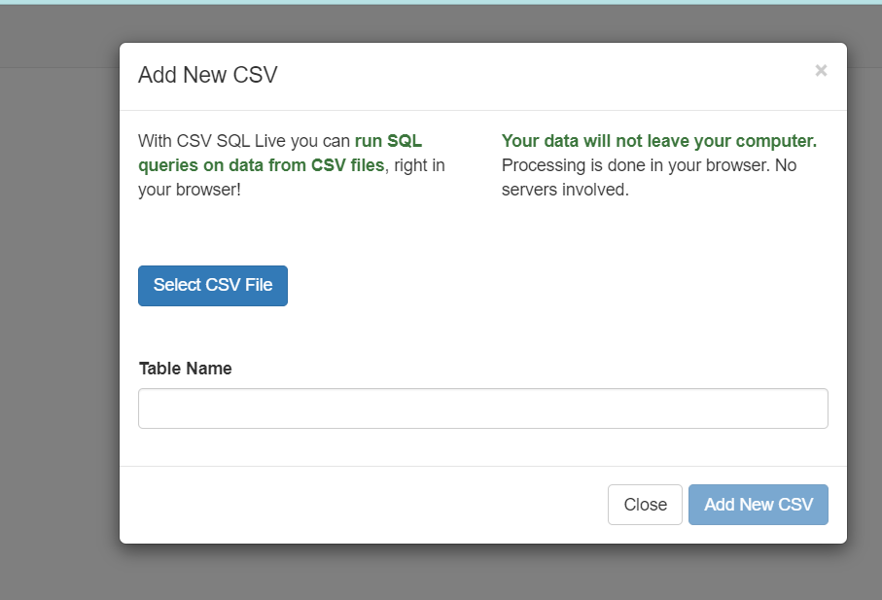
ADD CSV FILE FOR QUERIES:-
UPLOAD DATASET IN HERE…

Slide 3
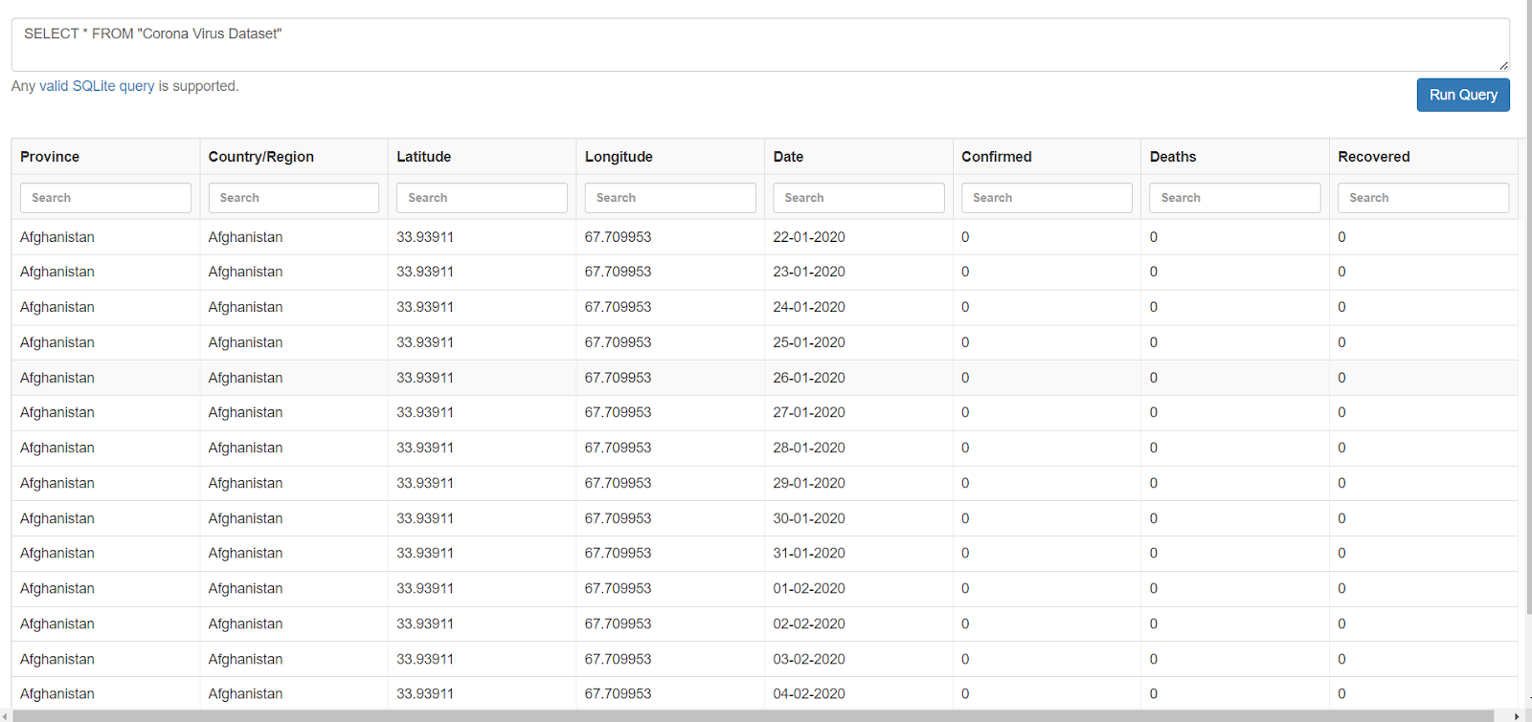
DATASET IS LOADED AND READY FOR THE QUERIES.
We used SELECT * that selects all the data from the dataset.

Slide 4
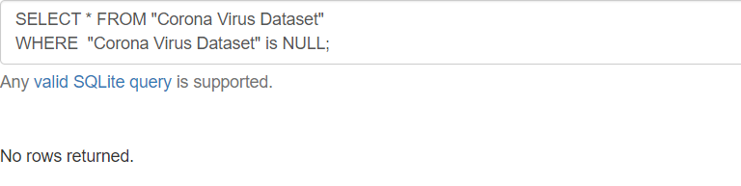
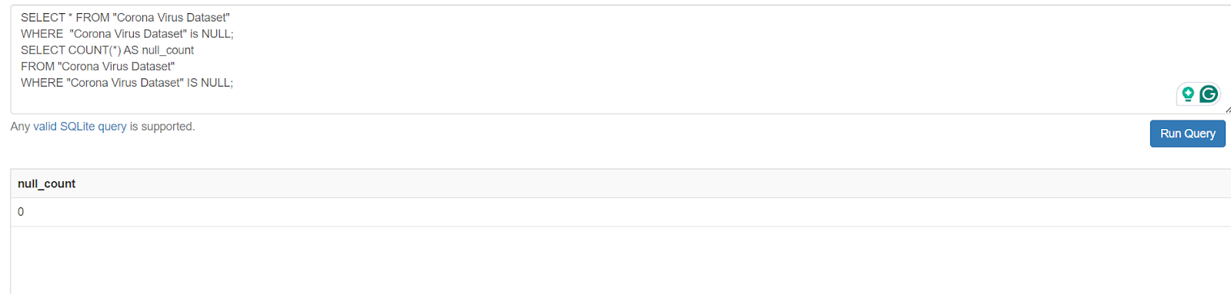
QUERIES AND CODES AND OUTPUTS:
Q1. Write a code to check NULL values ?
CODE:-
SELECT * FROM "Corona Virus Dataset"
WHERE "Corona Virus Dataset" IS NULL;
CODE:-
SELECT * FROM "Corona Virus Dataset"
WHERE "Corona Virus Dataset" is NULL;
SELECT COUNT(*) AS null_count
FROM "Corona Virus Dataset"
WHERE "Corona Virus Dataset" IS NULL;
******All the rows are Not NULL.******

Slide 5
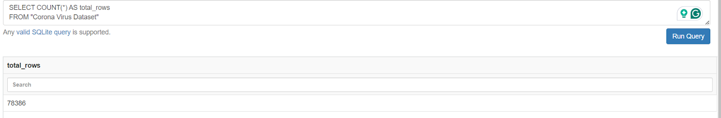
Q2. If NULL values are present, update them with zeros for all columns?
SO as we can see from the above pic, it shows that there are no NULL spaces from the Dataset So, there is no Update needed in the columns.
Q3. check total number of rows?
QUERY:-
SELECT COUNT(*) AS total_rows
FROM "Corona Virus Dataset"

Slide 6
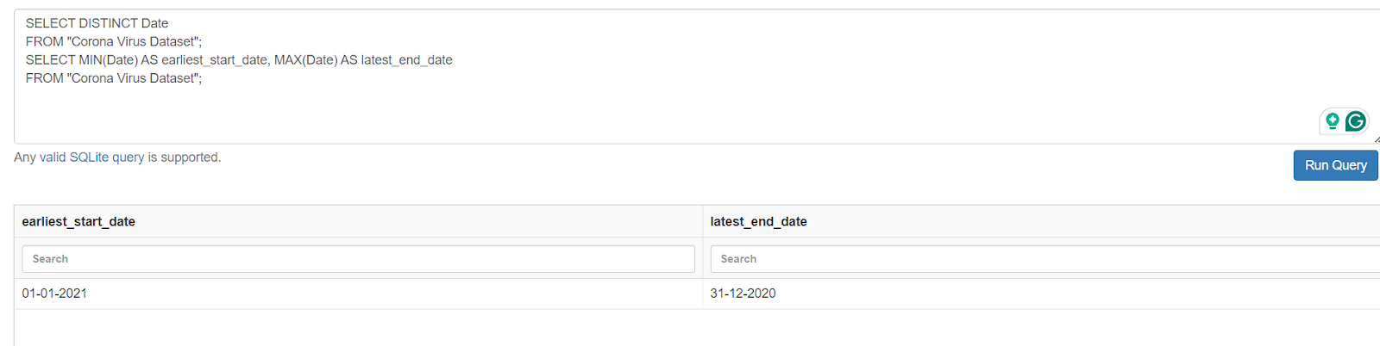
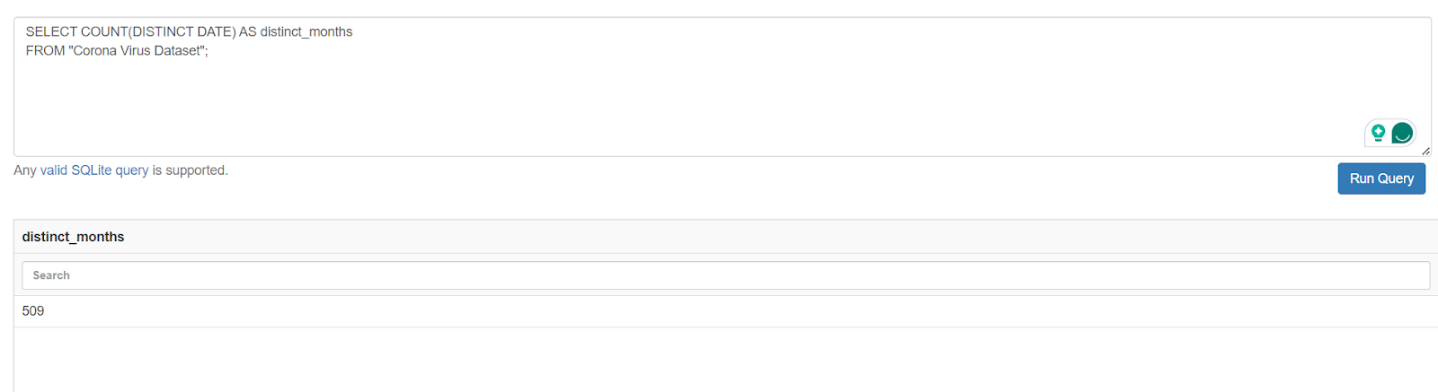
Q4. Check what is start_date and end_date?
QUERY:-
SELECT DISTINCT Date
FROM "Corona Virus Dataset";
SELECT MIN(Date) AS earliest_start_date, MAX(Date) AS latest_end_date
FROM "Corona Virus Dataset";
Q5. Number of month present in dataset?

Slide 7
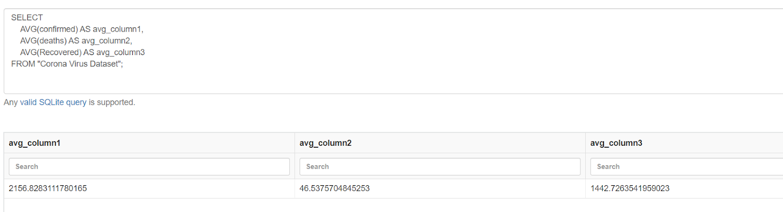
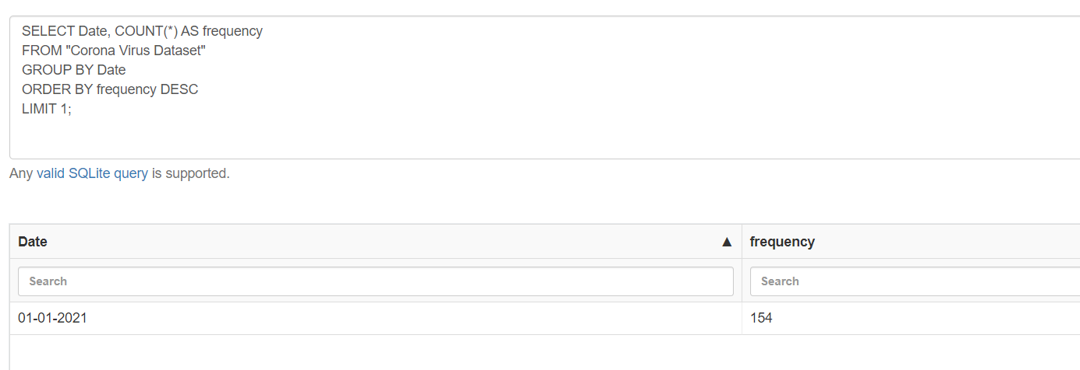
Q6. Find monthly average for confirmed, deaths, recovered?
Q7. Find most frequent value for confirmed, deaths, recovered each month?

Slide 8
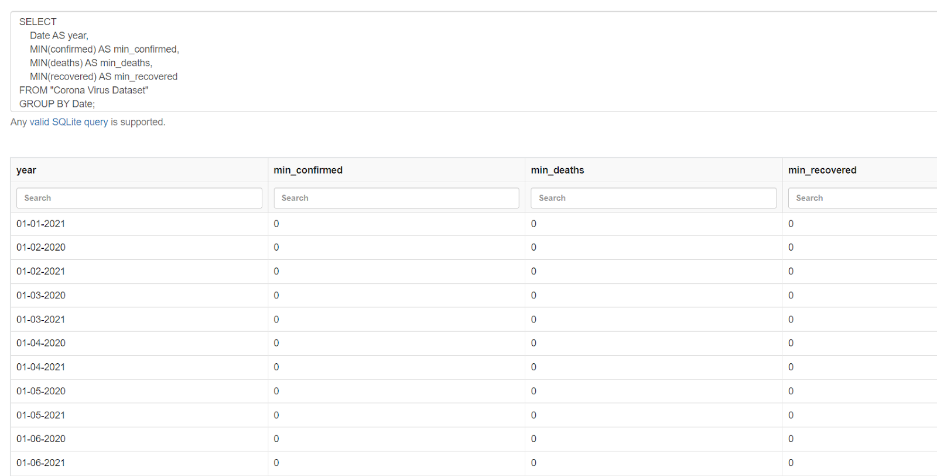
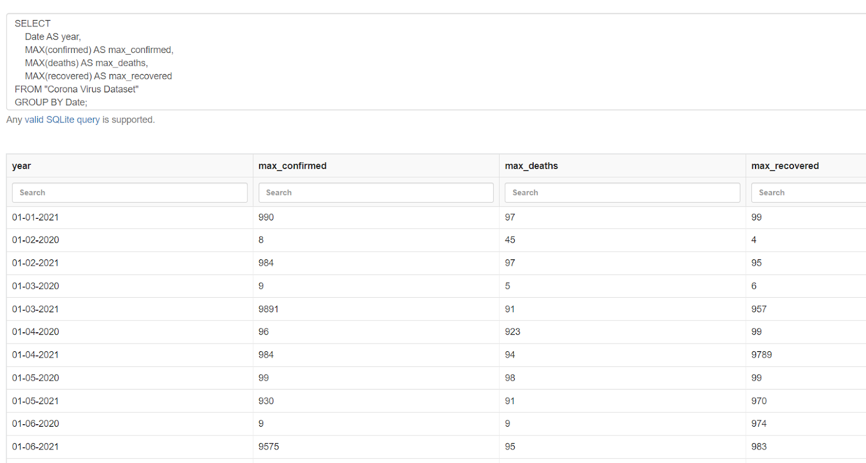
Q8. Find minimum values for confirmed, deaths, recovered per year?→
Q9. Find maximum values of confirmed, deaths, recovered per year?→

Slide 9
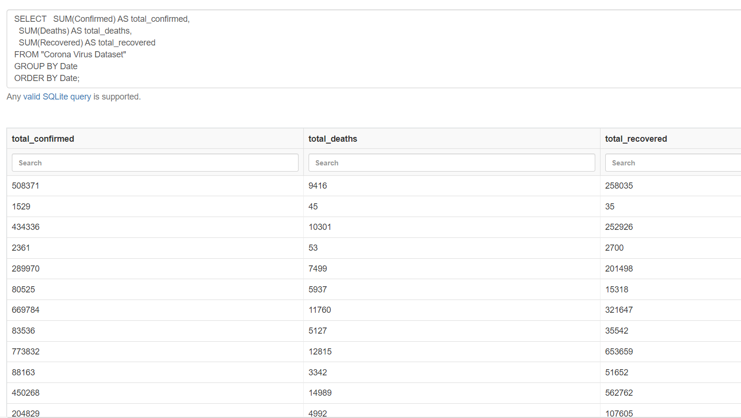
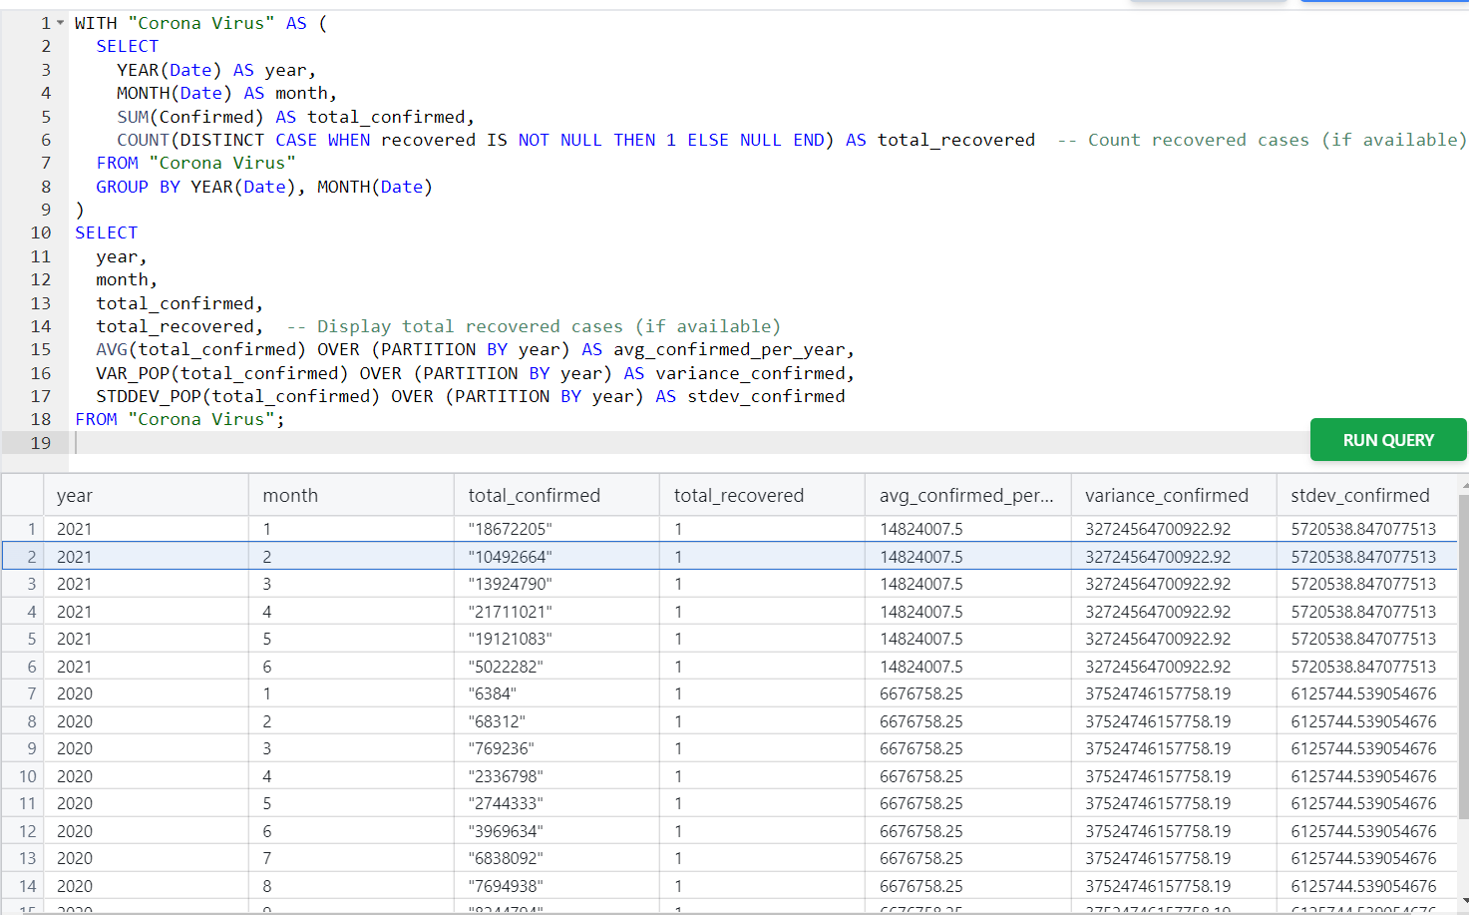
Q10. The total number of case of confirmed, deaths, recovered each month?
Q11.Check how corona virus spread out with respect to confirmed case?

Slide 10
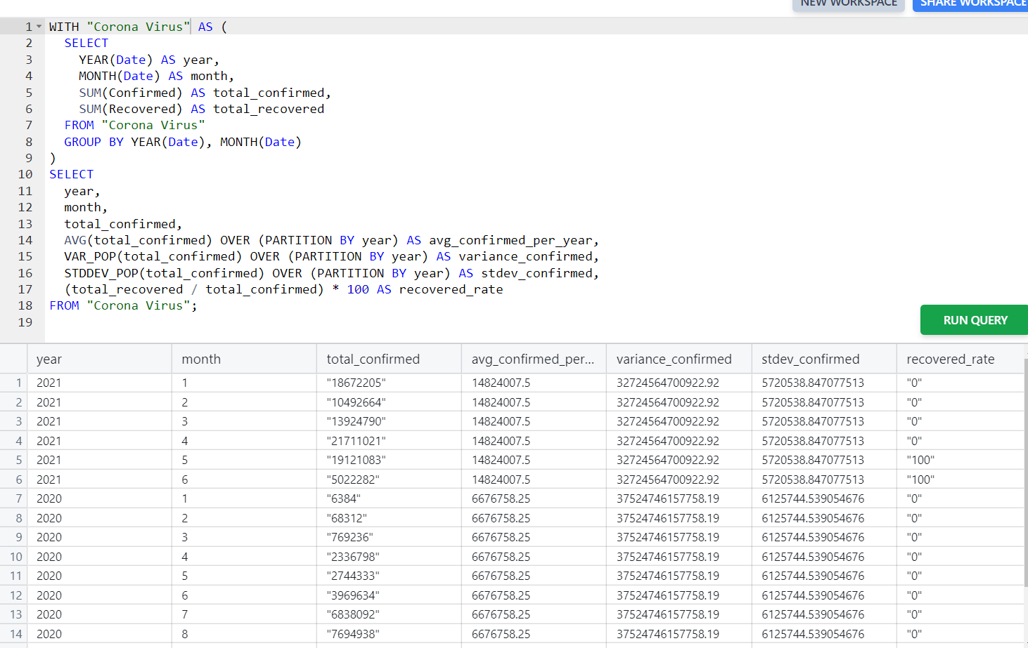
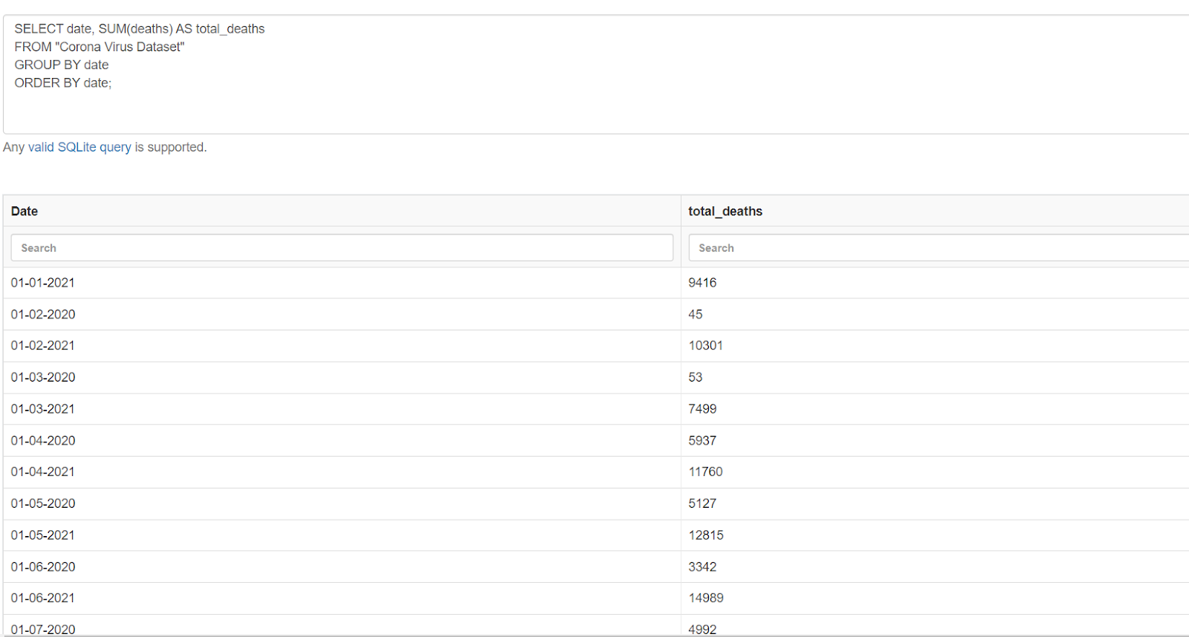
Q12.Check how corona virus spread out with respect to death case per month?
Q13. Check how corona virus spread out with respect to recovered case -- (Eg.: total confirmed cases, their average, variance & STDEV )

Slide 11
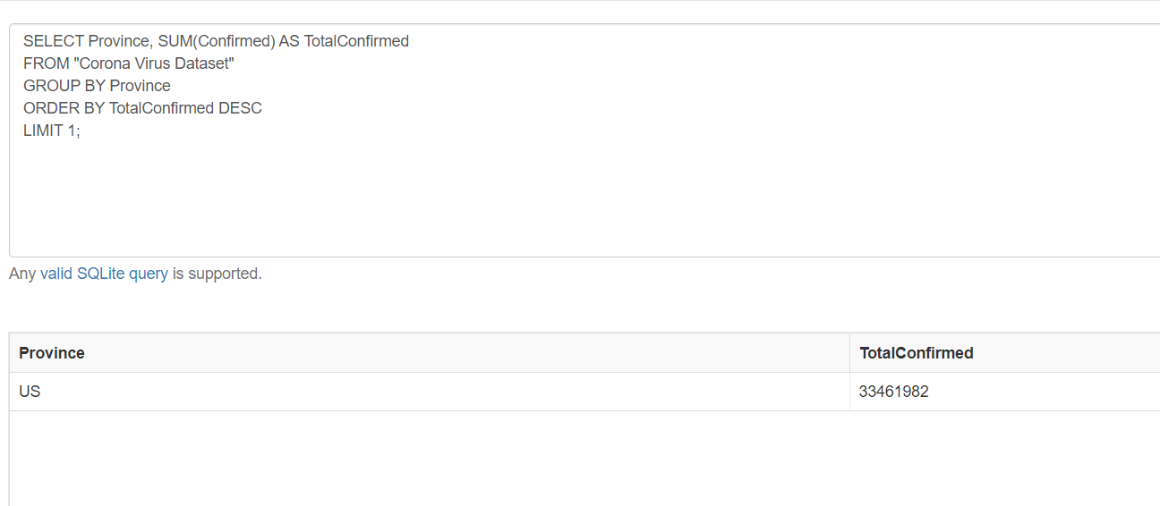
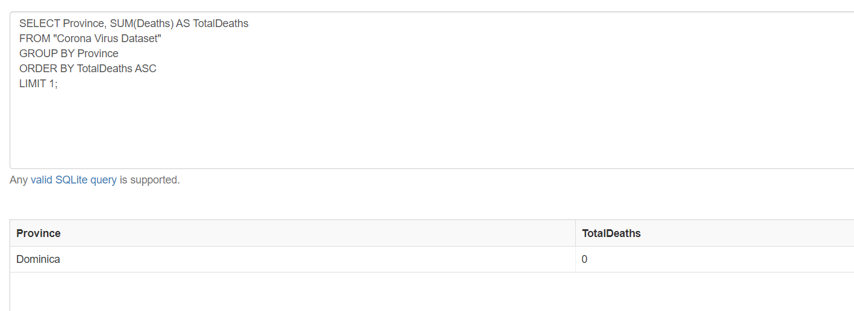
Q14. Find Country having highest number of the Confirmed case ?
Q15. Find Country having lowest number of the death case?

Slide 12
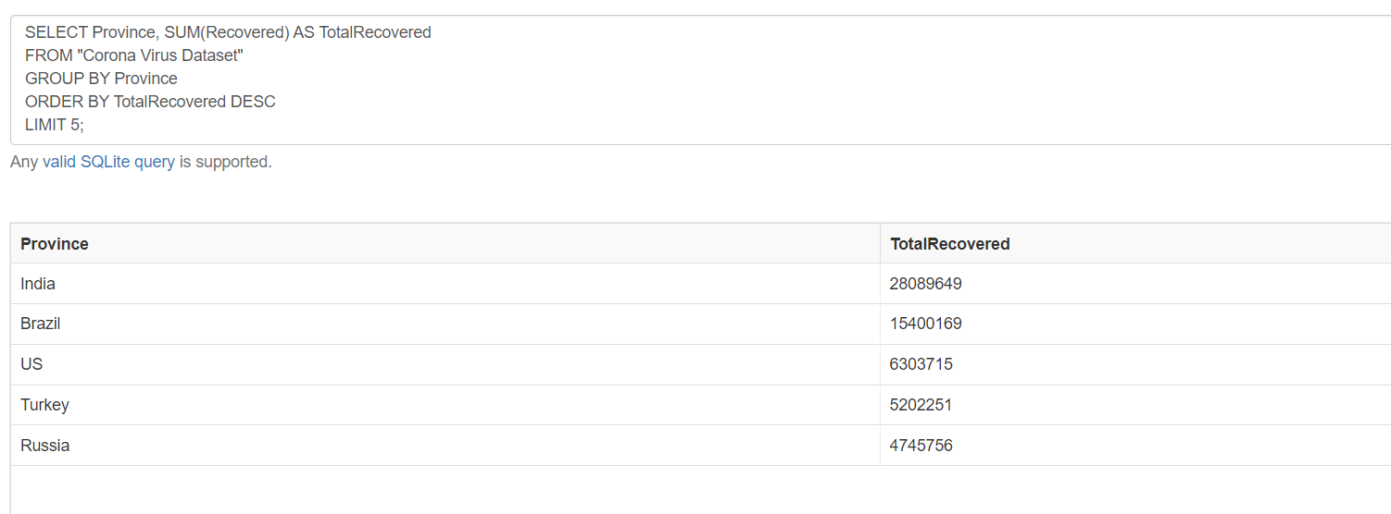
Q16. Find top 5 countries having highest recovered case ?
***********************************************THE END***********************************************

